Slide 1
Lecture 7-2 Design For Area Minimization
Tian Sheuan Chang

Slide 2
Outlines
Analysis of area cost
Algorithm: Complexity reduction
Architecture: resource sharing

Slide 3
Analysis of Area costs

Slide 4
Synthesis
Synthesis = Translation + Logic Optimization + Technology Mapping
Translation
a
1
0
always @ (a, b)
case ({a,b})
2’b00: out = 1; 2’b01: out = 1; 2’b11: out = 1; default: out = 0;
endcase
1
1
0
FPGA
out = ab + ab + ab
0
Out
0
1
1
1
Logic
Optimization
out = a +b
b
2-input LUT
Technology Mapping
a b
Out
ASIC

Slide 5





Synthesis is Constraint-Driven
You should specify your constraints
(Delay)
Synthesis Constraint
(Area)
(Power Consumption)
Area
Synthesizer optimizes the design to meet the constraints
Large
Small
Short
Long
Delay

Slide 6

HDL for Synthesis
“Bad” HDL code does not allow efficient optimization during synthesis
Garbage in, garbage out!
Logic synthesizer doesn’t do magic! designer has to take some responsibility in coding.
Example:
input sub; input [3:0] a,b;
output [3:0] y;
wire [3:0] tmp;
assign tmp = sub ? ~b : b; assign y = a + tmp + {3’b0,sub}
input sub; input [3:0] a,b;
output [3:0] y;
assign y = sub ? (a-b) : (a+b)
a[3:0]
b[3:0]
a[3:0]
4
0
Y[3:0]
Y[3:0]
b[3:0]
4
0
4
1
Y[3:0]
Ci
4 ₁
sub
More efficient
sub

Slide 7
HDL for Synthesis (General Guidelines)
Think Hardware:
Write HDL hardware descriptions
Think of the topology implied by the code
Do not write HDL simulation models
No explicit delays
No file I/O
Think RTL:
Writing in an RTL coding style means describing:
Register architecture
Circuit topology
Functionality between registers
Synthesis tool optimizes logic between registers:
It does not optimize the register placement

Slide 8
How to Read You Area Reports
****************************************
Report : area
Design : prime
Version: 2003.06
Date : Sat Oct 4 11:38:08 2003
****************************************
Library(s) Used:
XXXXX
Number of ports: 5
Number of nets: 9
Number of cells: 5
Number of references: 4
Combinational area: 7.000000
Noncombinational area: 0.000000
Net Interconnect area: undefined (Wire load has zero net area)
Total cell area: 7.000000
Total area: undefined
****************************************
Report : timing
-path full
-delay max
-max_paths 1
Design : prime
Version: 2003.06
Date : Sat Oct 4 11:38:08 2003
****************************************
Operating Conditions:
Wire Load Model Mode: enclosed
Startpoint: in[2] (input port)
Endpoint: isprime (output port)
Path Group: (none)
Path Type: max
Des/Clust/Port Wire Load Model Library
------------------------------------------------
prime 2K_5LM XXXXX
Point Incr Path
-----------------------------------------------------------
input external delay 0.000 0.000 r
in[2] (in) 0.000 0.000 r
U4/Y (EX210) 0.191 0.191 f
U5/Y (BF051) 0.116 0.307 r
U1/Y (BF052) 0.168 0.475 f
isprime (out) 0.000 0.475 f
data arrival time 0.475
-----------------------------------------------------------
(Path is unconstrained)
Noncombinational part: DFF, SRAM, latch
Left part: area report
Right part: timing report

Slide 9
Area Estimation
1 DFF, 1 adder, 1 2:1 MUX:
7 gate counts
1 gate count == NAND2x1 area
Multiplier: depends on architecture
NxN => N^2 * 7
Estimate data flow part first
How many adder/multiplier have been used
Control part (FSM)
Extra 5 to 10% area cost

Slide 10
Where your area goes?
Use Synopsys Design Compiler to analyze this
Not covered in this course
Code review
Sequential part: Count DFF numbers generated in each always_ff
Unique output variables in the Verilog commands
Avoid unnecessary pipeline or DFF storages
Data path part
Count adder/multiplier and other and/or logic
Controller part
Simplify your FSM
Rule of thumb
Controller: take 5 to 10% of area
Data path takes 40% to 70%, memory or buffers takes the rest

Slide 11
Complexity Reduction
Easy to do
Remove constant operations or
Simplify operations
Find common terms/regularity/shared data in the algorithms (e.g. share DFF in parallel FIR filter, or complex if-else conditions)
Algorithm optimization
Application dependent
Something more like used in C program
E.g. assign y = a * b;
If b = 4’h2;
assign y = a << 1;

Slide 12
Area optimization

Slide 13
Concept
Folding (or rolling up the pipeline)
Time sharing the same logic to save area
Algorithm change

Slide 14
Area-related Techniques:
Area is the second primary factors of a digital design
A topology that targets area is one that reuses the logic resources to the greatest extent possible, often at the expense of throughput (speed).
This requires a recursive data flow, where the output of one stage is fed back to the input for similar processing.

Slide 15
Area-related Techniques: Rolling Up the Pipeline
Opposite to the unrolling the loop to increase throughput
Unrolling the loop achieved by adding more registers to hold intermediate values, i.e., more area
Thus to reduce the area the reversed action should be done (i.e., Sharing)
Resource Sharing is used where there are functional blocks that can be used in other areas of the design or even in different modules
Sharing logic resources requires special control circuitry to determine which elements are input to the particular structure

Slide 16
Rolling Up the Pipeline
Calculation of P = A*B
A: a normal integer with the fixed point just to the right of the LSB (8 bits)
B: a fractional number with a fixed point just to the left of the MSB (8 bits)
P: the product, which requires only 8-bits
One implementation alternative:
Critical path: one multiplier (complex itself)
One product every clock cycle (high throughput)
module mult8(
output [7:0] P,
input [7:0] A,
input [7:0] B, input clk);
reg [15:0] prod16; assign P= prod16[15:8]; always @(posedge clk) prod16 <= A * B; endmodule

Slide 17
Rolling Up the Pipeline : Resource Sharing
Rolling Up the Pipeline:
Using series of shift-and-add operations
Smaller critical path
Less area due to the simple operations and sharing
One product every 8 clock cycles! (low throughput)
module mult8(output done,output reg [7:0] product, input [7:0] A, input [7:0] B, input clk, input start);
reg [4:0] multcounter; // number of shift/adds reg [7:0] shiftB; // shift register for B
reg [7:0] shiftA; // shift register for A wire adden; // enable addition assign adden = shiftB[7] & !done; assign done = multcounter[3]; always @(posedge clk) begin if(start) multcounter <= 0;
else if(!done) multcounter <= multcounter + 1;
// shift register for B if(start) shiftB <= B;
else shiftB[7:0] <= {shiftB[6:0], 1’b0};
// shift register for A
if(start) shiftA <= A;
else shiftA[7:0] <= {shiftA[7], shiftA[7:1]};
// calculate multiplication if(start) product <= 0;
else if(adden) product <= product + shiftA;
end
endmodule

Slide 18


Resource Sharing: Area Reduction Technique
Back to FIR Filter:
Three multiplications, two adders, two registers
X(n)
X(n-1)
X(n-2)
a
b
c
Y(n)
Y(n) = ax(n) + bx(n-1) + cx(n-2)

Slide 19
Resource Sharing: Area Reduction Technique
Sharing the Multiply-Accumulate (MAC) to reduce area:
One multiplication, one adder, one register
Requires some control logic to determine which input is inserted (FSM)
Coeff
Coeff
DataIn
X0
multcoeff
accum
0
multout
DataIn
X1
accumsum
Out
multdat
0
16'b0
1
X2
16'b0
1
MAC
State == 0
State == 0
DataIn=X[0], 0,0,0, X[1], 0,0,0,X[2], ….
Coeff= a, b, c, 0,a, b, c, 0, ...
State

Slide 20
Resource Sharing: Area Reduction Technique
module sharing( output reg [15:0] Out, input clk,
input [7:0] datain, // X[0]
input [7:0] coeffA, coeffB, coeffC); // coeffs for low pass filter
// define input/output samples
reg [7:0] X0, X1, X2;
reg [2:0] state; // holds state for sequencing through mults wire [15:0] accum; // accumulates multiplier products
reg [15:0] accumsum;
wire [15:0] multout; // multiplier product reg [7:0] multdat;
reg [7:0] multcoeff;
assign multout =(state==0)?16'b0:multcoeff * multdat;
// clearing and loading accumulator
assign accum = (state==0)?16'b0:accumsum;
always @(posedge clk)
accumsum <= accum + multout;
always @ (posedge clk) begin
case(state)
0: begin // load new data
X0 <= datain; X1 <= X0; X2 <= X1;
multdat <= datain; multcoeff <= coeffA; state <= 1;
Out <= accumsum;
end
1: begin // A*X[0] is done, load B*X[1] multdat <= X1; multcoeff <= coeffB; state <= 2;
end
2: begin // B*X[1] is done, load C*X[2] multdat <= X2; multcoeff <= coeffC; state <= 3;
end
3: begin // C*X[2] is done, load output state <= 0;
end default
state <= 0;
endcase end endmodule

Slide 21
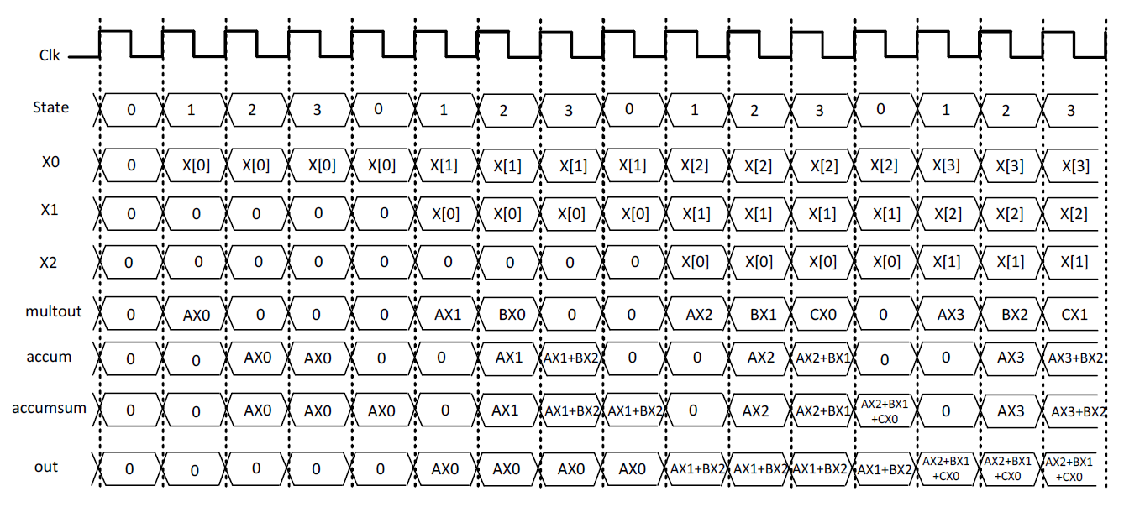
Resource Sharing: Area Reduction Technique

Slide 22
Resource Sharing: Area Reduction Technique
HDL coding style can force a specific topology to be synthesized
SUM1 = A+B+C; SUM2 = A+B+D; SUM3 = A+B+E;
assign tmp = A+B; SUM1 = tmp +C; SUM2 = tmp +D; SUM3 = tmp +E;
A B C
A
B
D A
B
E
A
B C
D
E
Sharing
SUM1
SUM2
SUM3
SUM1
SUM2
SUM3

Slide 23
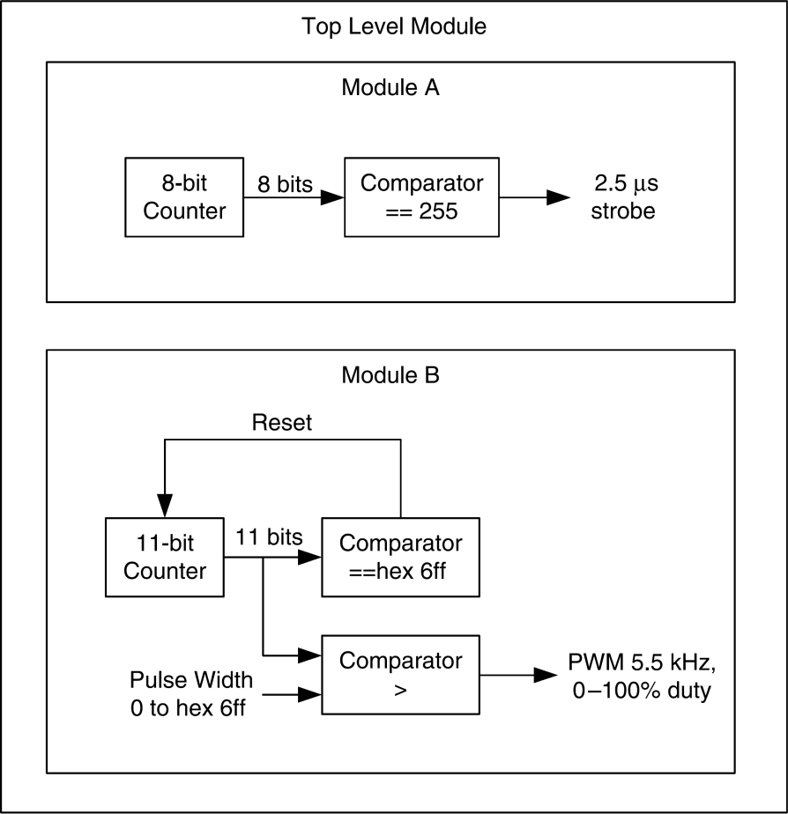
Resource Sharing: Area Reduction Technique
Let’s assume we have two counters controlling different design sections
CounterA, a free running 8-bit counter
CounterB, an 11-bit counter, counting from 0 to 1666 and resets to zero

Slide 24
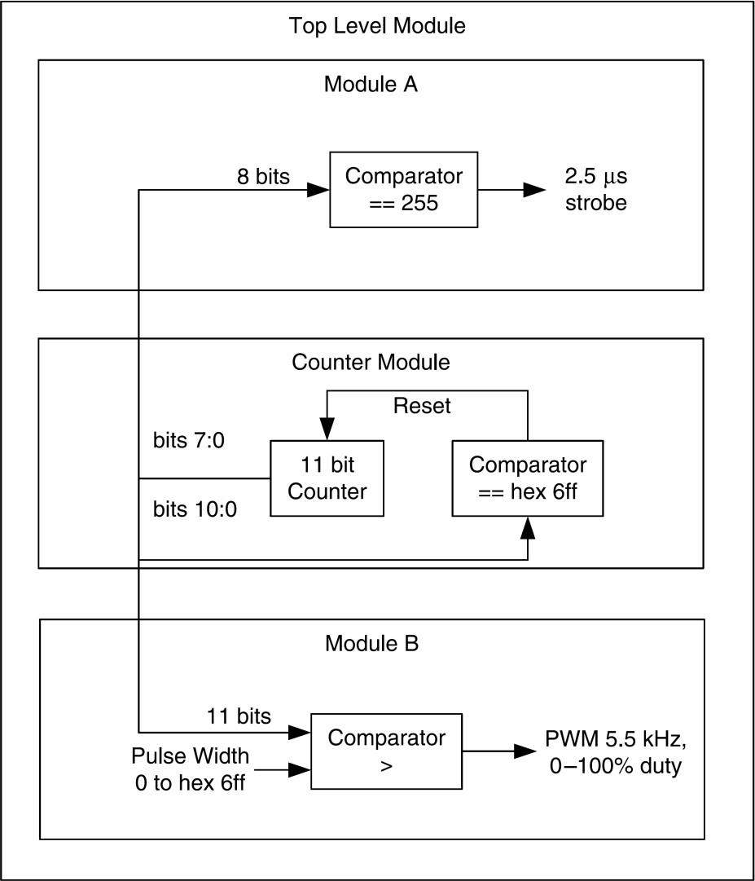
Resource Sharing: Area Reduction Technique
Resource-shared version of these two counters
For compact designs where area is the primary requirement, search for resources that have similar counterparts in other modules that can be brought to a global point in the hierarchy and shared between multiple functional areas.
Shared Part

Slide 25
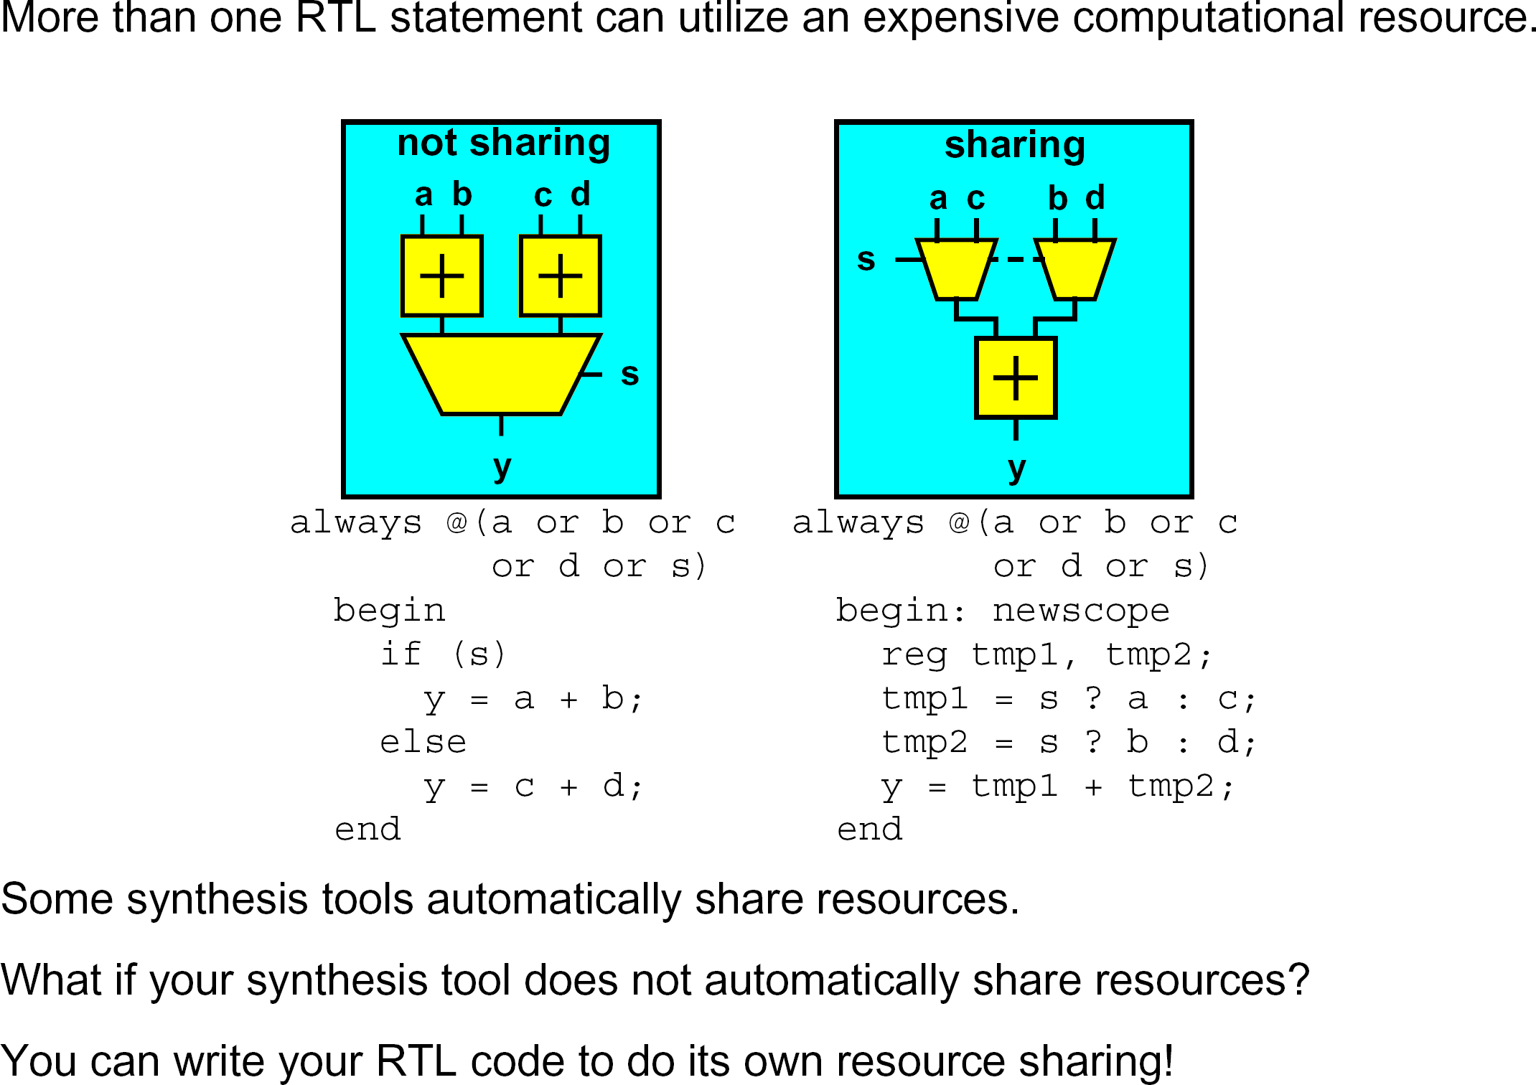
Architectural Techniques : Resource Sharing

Slide 26
Resource sharing
assign y = a == 1 ? b * c : e * f;
t1 = a == 1 ? b : e; t2 = a == 1? c : f; y = t1 * t2;
Find the resource that can be shared
Resource: high area cost part, like adder, multiplier
Tool may or maynot find these opportunities

